Slide 1
apparel with a mission

Slide 2
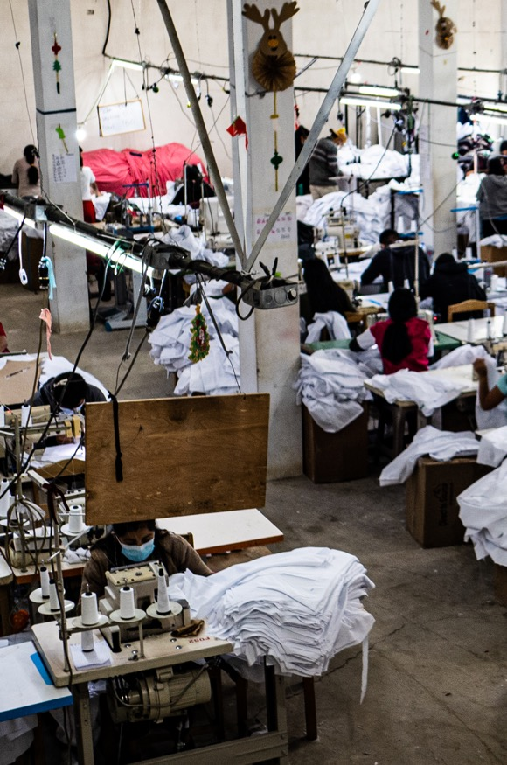
custom apparel, ethically sourced
Direct to Source was born out of love. Love for the apparel industry, love for the craftsman, and love for growing brands. We are a state of the art one-stop production facility in Guatemala with US offices that provides custom private label apparel production.

Slide 3
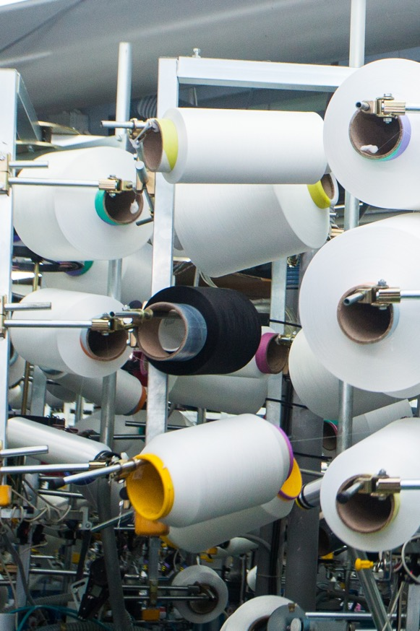
make a positive impact on the world
We are here to prove that quality apparel can be ethically and sustainably produced. Direct to Source was founded on the notion that clothing brands can grow their business through ethical practices, sustainable materials, and unique designs.

Slide 4
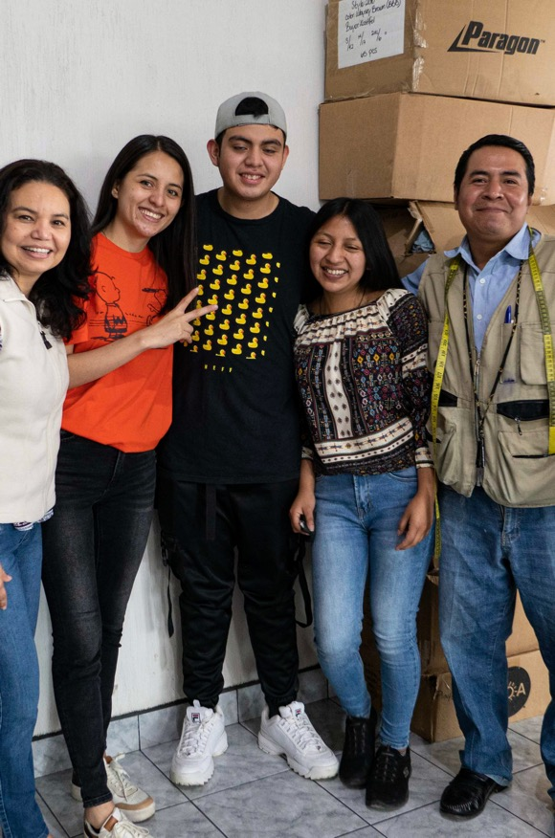
people deserve to be valued
People deserve well-paying jobs in safe and healthy environments. Our Guatemala facility is staffed by full-time employees who are paid an ethical wage. We care for and respect our employees and support them through business built with integrity.

Slide 5
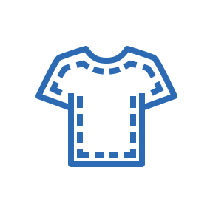
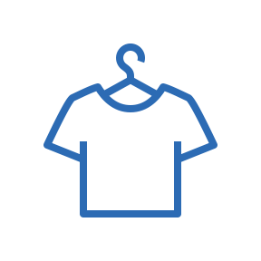
private label apparel production
Design
You ask for it, we provide it. Our customized apparel starts with our extensive design capabilities.
Patterning
Accurate patterns are key to making your designs a reality.
Samples
Ensure your designs are perfect before production.

Slide 6
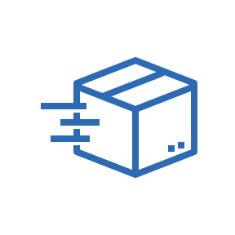
private label apparel production (cont.)
Sourcing
Always ethical with people and planet in mind.
Sewing
We count on our team to use their talents and skills to create true works of art.
Shipment
Our delivery times are measured in weeks, not seasons.

Slide 7
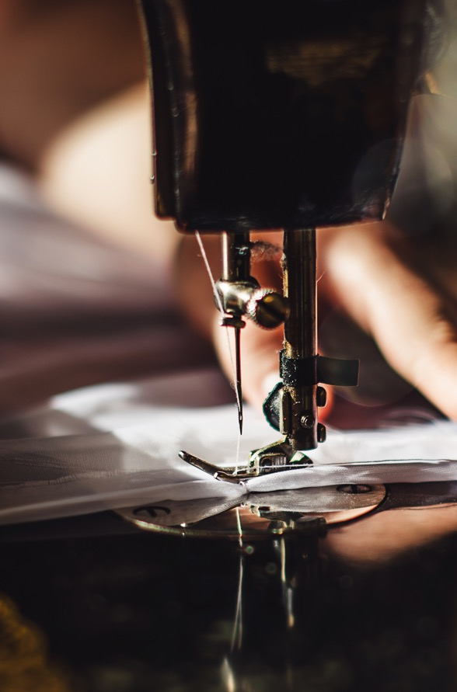
our customers
In a time of instant gratification and lightning-fast delivery times, we offer flexibility and consistency to our customers.
We offer in-stock programs, so we are ready for quick turnaround and replenishment.

Slide 8
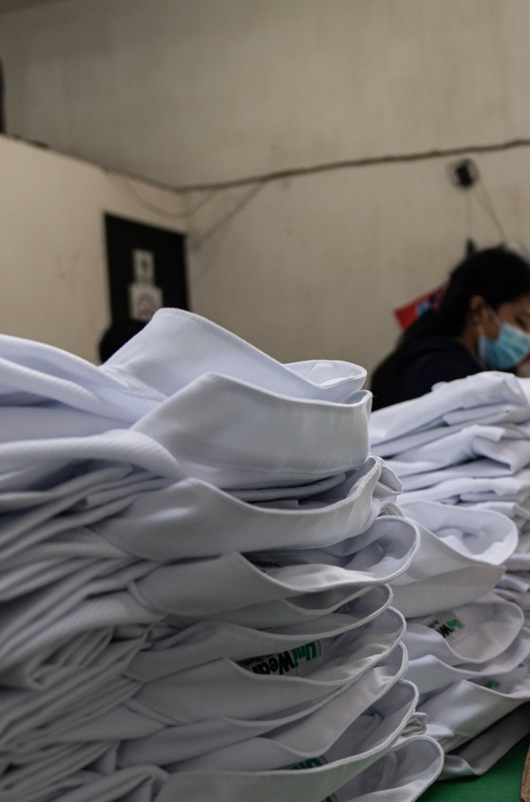
our manufacturing facility
Our San Pedro facility was built to follow WRAP standards and meets applicable international codes.
This facility is an open space with wonderful airflow, plenty of light, and windows to see the amazing views.
We are Amazon certified for quality and social compliance and Hey Social Good Gold certified.

Slide 9
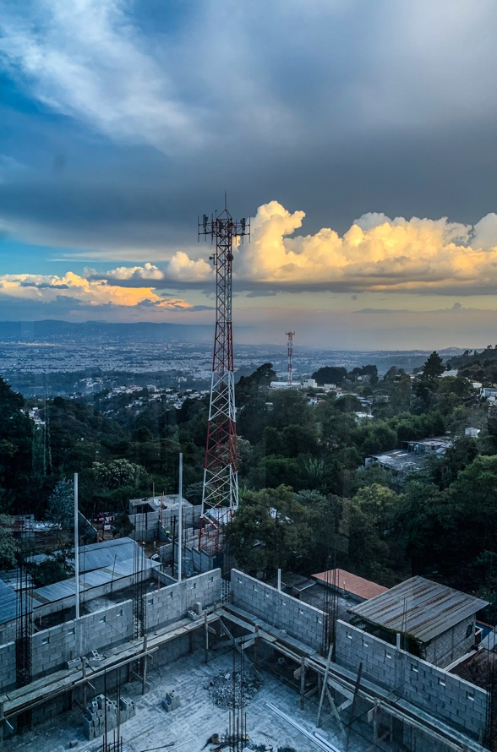
our future
We currently benchmark against 9 of the UN’s Sustainable Development Goals and are working to see what other areas we can contribute in.
We have begun a program to recycle our fabric cutting scraps, as well as a donation program to provide clothes to locals in need.

Slide 10
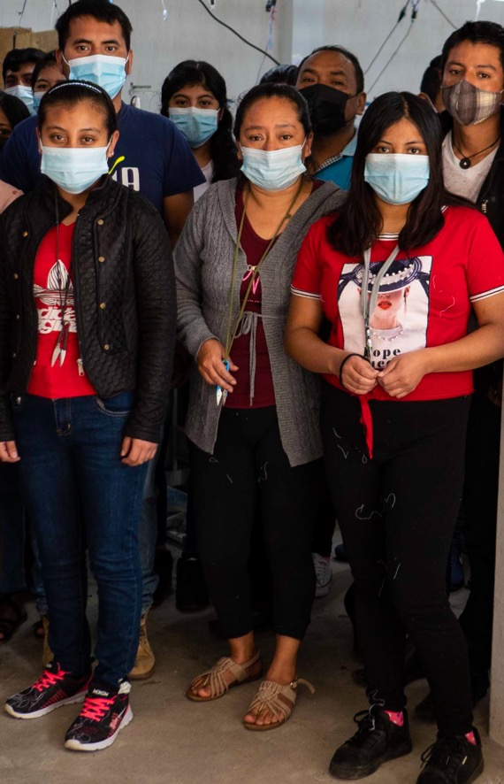
let’s make a difference together
P.O. Box 7006 Golden, CO 80403
970-591-2116
directosource.com

